Slide 1
Key Components of a Blazor Application

Slide 2
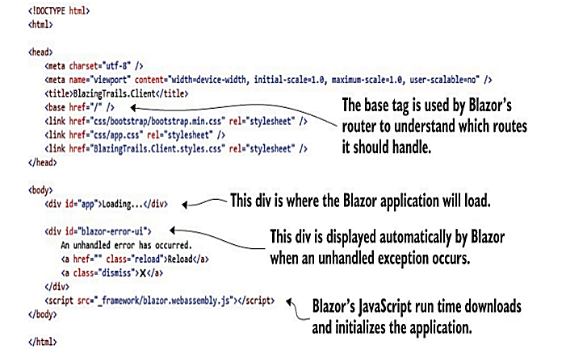
Index.html
Index.html is one of the most important components of a Blazor WebAssembly application. It can be found in the wwwroot directory of the project, and it’s the host page for the Blazor application.

Slide 3
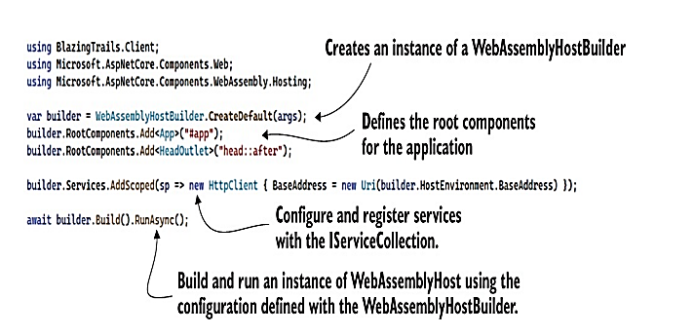
Program.cs
Just like other ASP.NET Core applications, Blazor apps start off as .NET console apps. What makes them a Blazor application is the type of host they run. In the case of Blazor WebAssembly, it runs a WebAssemblyHost. The purpose of the code contained in this file is to configure and create that host. Figure 2.9 shows the default configuration of the Program class.

Slide 4
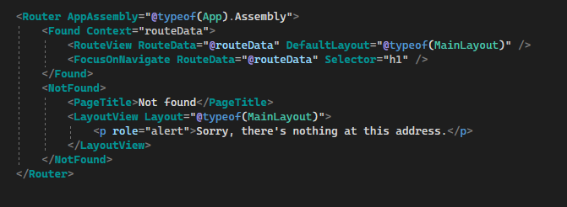
App.Razor
This is the root component for a Blazor application, and we saw how thiswas configured in the Program.cs file in the previous section. This doesn’t have to be the case; however, you can configure a different component to be the root component if you wish. Or you can even have multiple root components. You just need to update the configuration in the Program.Main method.
The App component contains a vital component for building multipage applications—the Router component. This component is responsible for managing all aspects of client-side routing. When an application first starts up, the router will use reflection to scan the application’s assemblies for any routable components (we’ll talk about these in more detail in chapter 4, but they’re essentially pages). It then stores information about them in a routing table. Whenever a link is clicked or navigation is triggered programmatically, the router will look at the requested route and try to find a match in the routing table. If a match is found, then it will load that component; otherwise it will load a Not Found template, which is specified inside the Router component

Slide 5
wwwroot folder and _Imports.razor
By convention, all ASP.NET Core applications have a wwwroot folder, which is used to store public static assets. This is the place where you can put things such as images, CSS files, JavaScript files, or any other static files may need. Anything you put in this folder will be published with your application and available at run time. As I mentioned earlier, this is also where the index.html file is kept.
The _Imports.razor file is optional when building a Blazor application. However, it’s useful to have at least one of these files. Its job is to store using statements. The benefit is that those using statements are made available to all the components in the file’s directory and any sub directories. This saves you having to add common using statements to every component in your application.

Slide 6
Pages and Shared Folders
By default, the app structure used by the template divides files by responsibility. There’s a Pages folder for routable components, and there’s a Shared folder for anything that is used in multiple places or is a global concern.

